Slide 1
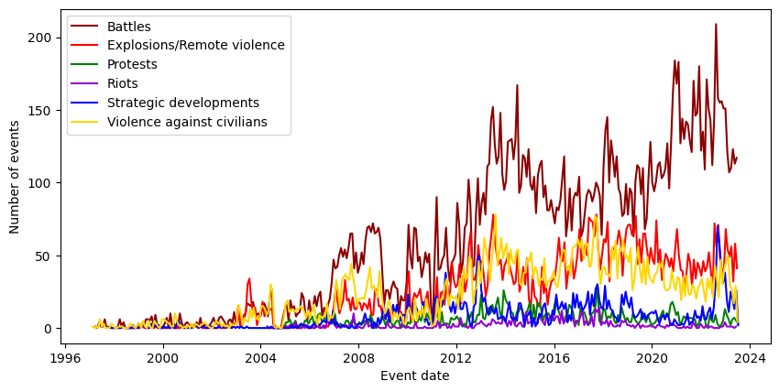
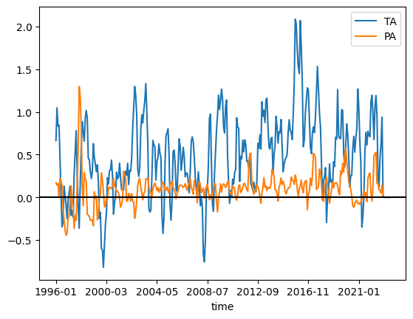
Weather, conflicts and IDPs in Somalia

Slide 2
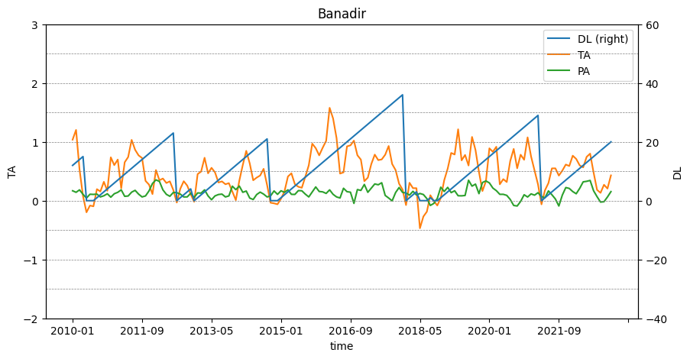
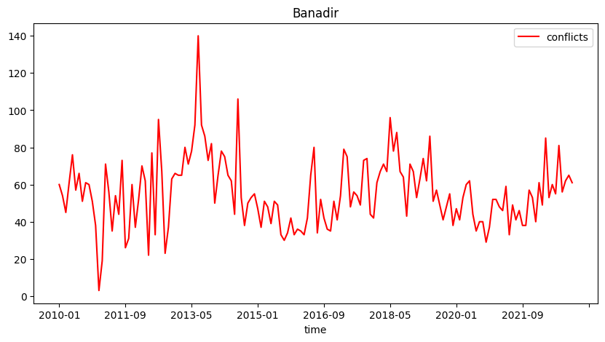

Slide 3
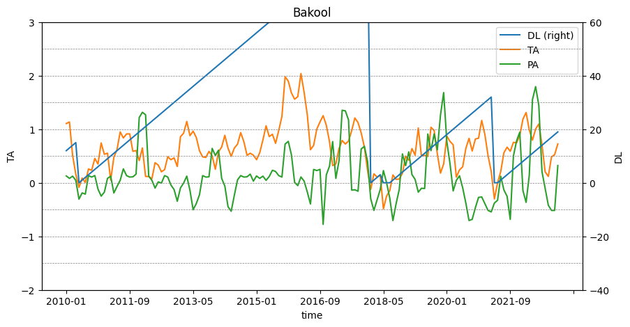
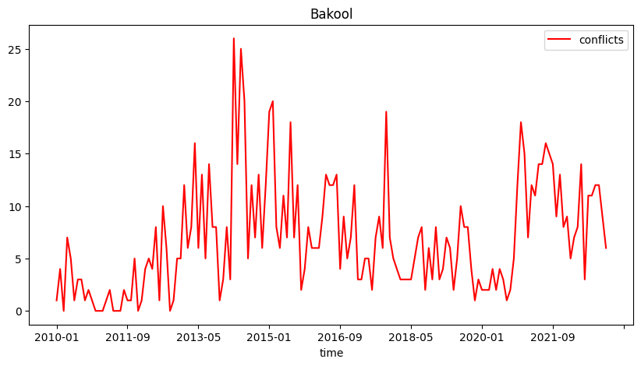

Slide 4
Data
Extreme weather → temperature and precipitation anomalies, sourced from University of East Anglia Climatic Research United (UEA-CRU 2011)
Conflict data → Armed Conflict Location and Event Data Project (ACLED) database, which records violent conflict events
Displacement data → Protection and Return Monitoring Network (PRMN) survey, collected by the United Nations High Commissioner for Refugees (UNHCR)

Slide 5
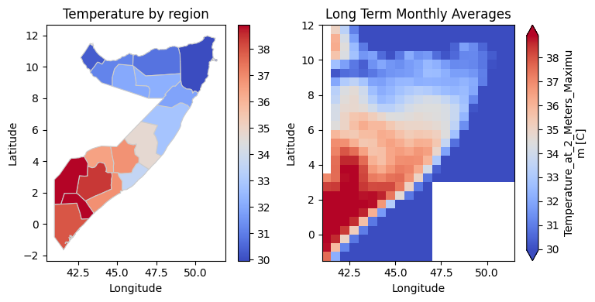
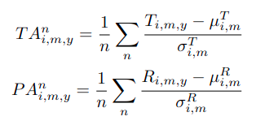
Variables
Transformed the gridded temperature data into a single data point for each administrative unit
Computed the long-term averages for each region and each month, from 1901
Computed the standardized difference with the maximum temperature for each region and for each month
Calculated a moving average of these standardized values over a window of 3 and 4 months
Drought Lenght variable is defined as the number of consecutive months with positive temperature anomalies.

Slide 6
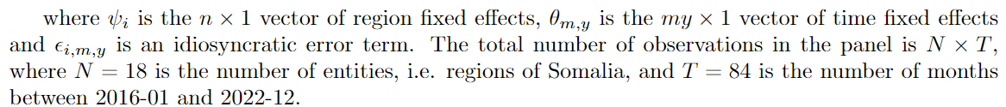
Reduced-form regression

Slide 7
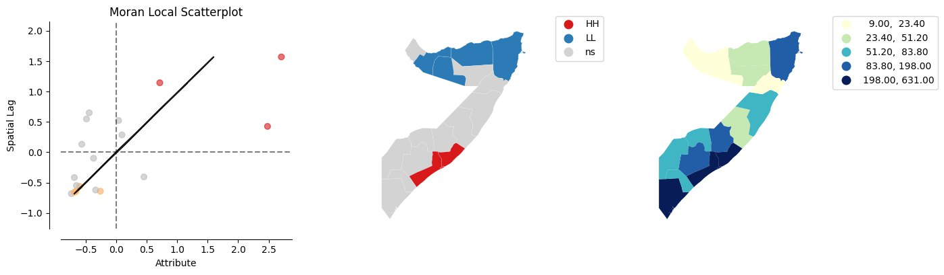
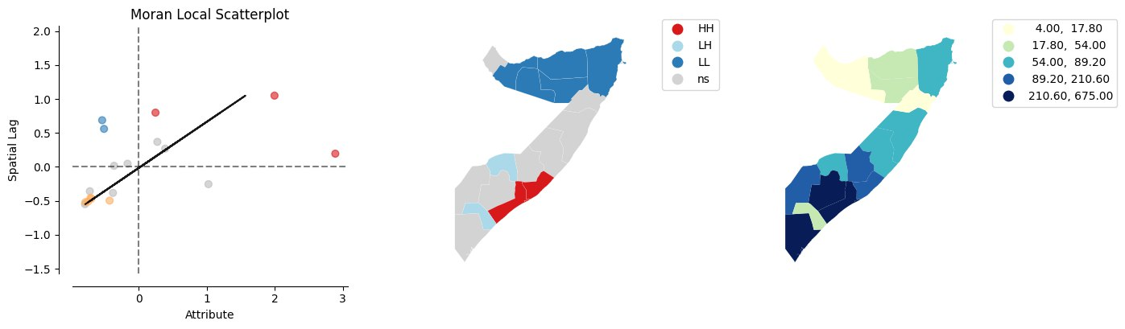
Spatial autocorrelation
2019
2020

Slide 8

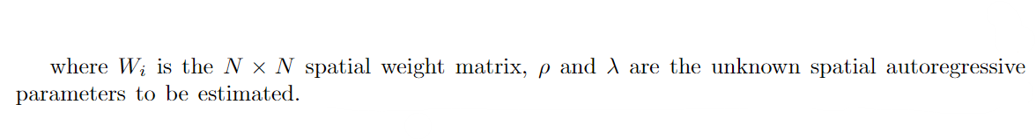
Spatial Lag Model
SAR model
SARAR model

Slide 9
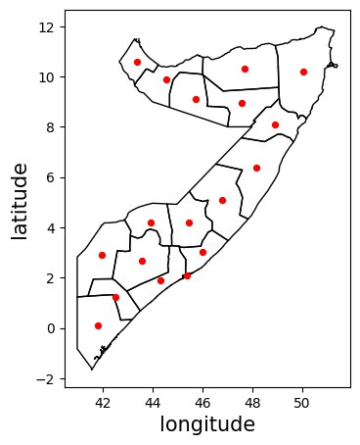
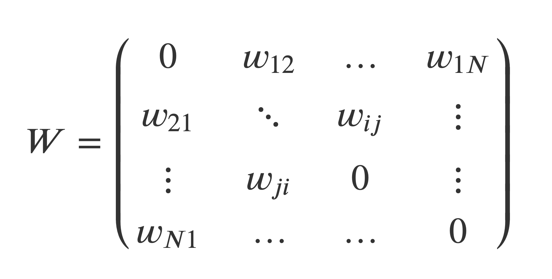
Spatial weight matrix
Adjacency matrix, where neighbouring regions weight 1 and the rest 0
Normalised inverse distance matrix, calculated between the centroids of the regions
regions in direct proximity have a greater influence compared to those situated at greater distances
influence decreases over space but is still accounted for in non-neighbouring regions.

Slide 10
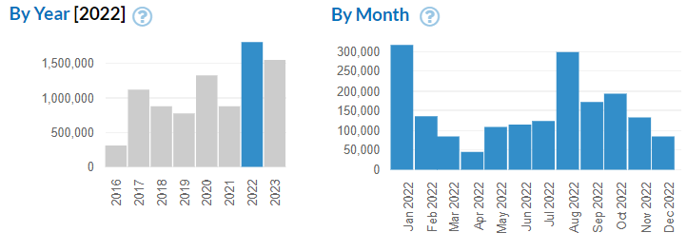
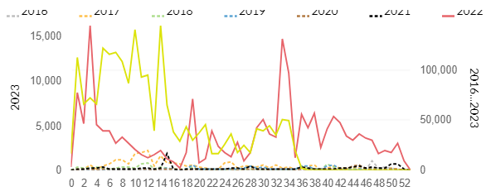
Internal displacements
There has been a significant increase in the
number of IDPs in the past years
Number of IDPs in Somalia, by week
2016 2017 2018 2019 2020 2021 2022

Slide 11

Spatial Lag Model + IDPs
SAR + IDPs
SARAR + IDPs

Slide 12
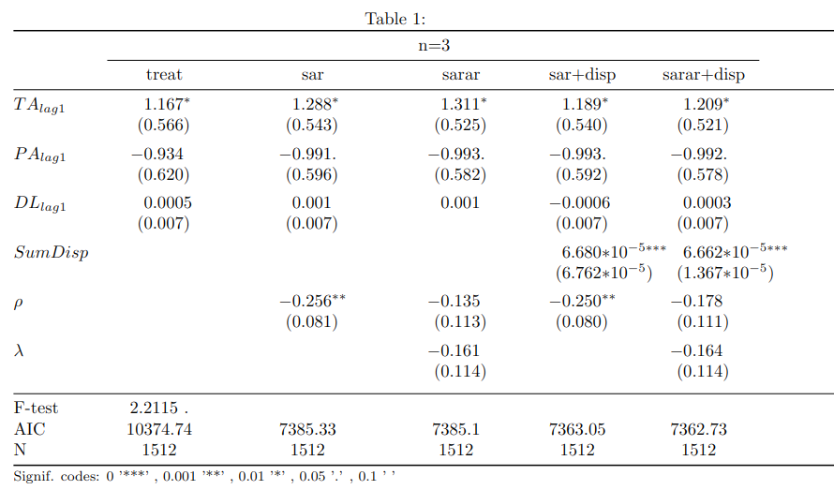
Results

Slide 13
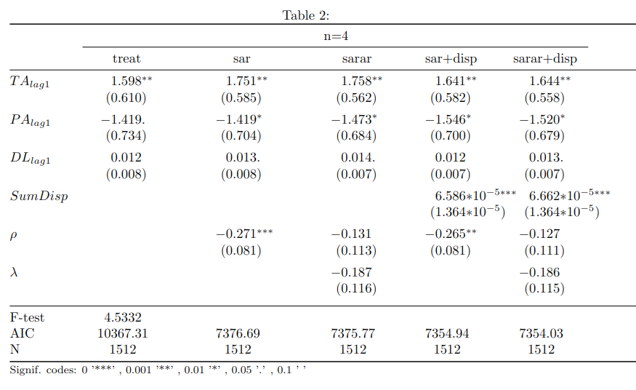
Results

Slide 14
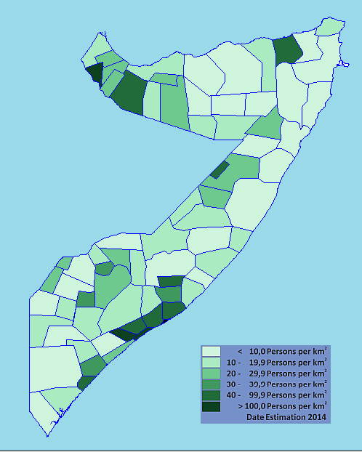
Population density
We incorporated population density as a control variable.
No statistical significance for this variable → the effect of population density is accounted for in the fixed effects
Absolute number of conflicts as the dependent variable, rather than conflicts per capita.

Slide 15
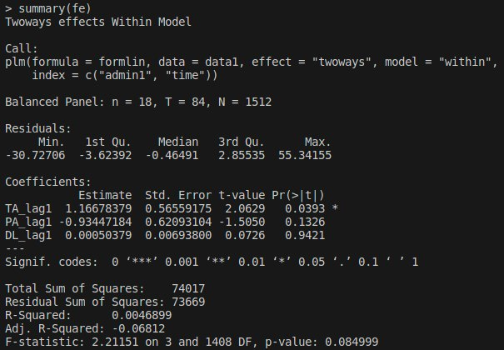
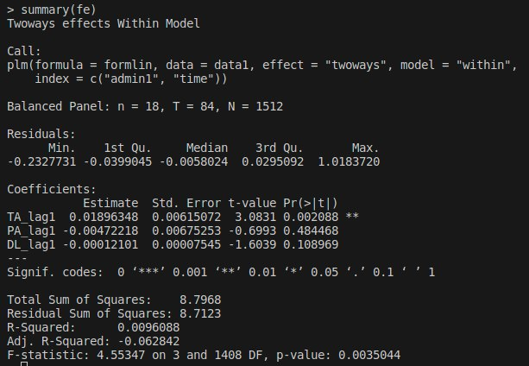
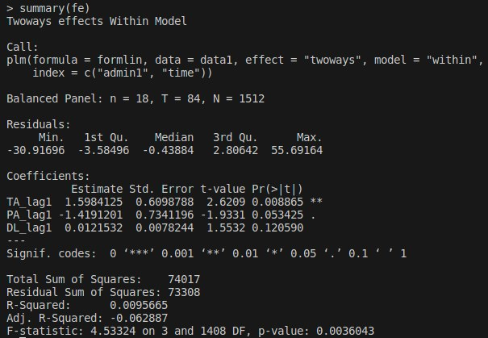
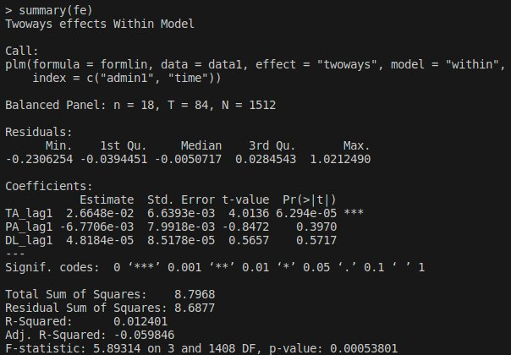
Absolute number of conflicts
Conflicts pro capite
n = 3
n = 4

Slide 16
New ideas?
Network analysis of displacements https://openknowledge.worldbank.org/server/api/core/bitstreams/2d2d931a-09c4-5b44-b1c1-67f19e3de6bd/content
Separable Temporal Exponential Random Graph Model (STERGM)
Keep linear regression model, but:
  Two-stage least-squares fixed-effect model (like Maystadt)
  Instrumental variable approach
Enlarge the area under study to neighboring countries and/or
Enlarge the time frame (they only study 2016-2018)
Go to Admin2 level
...

Slide 17
